Slide 1
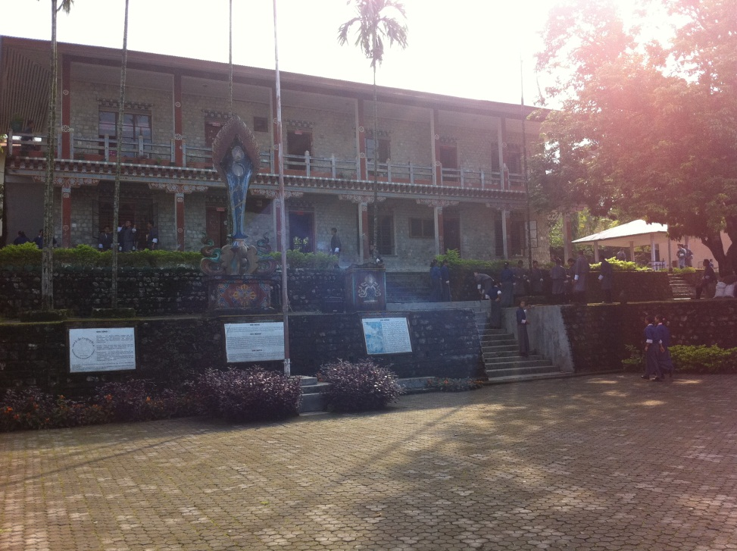
A typical lesson
A lesson
Samtse Secondary School
1. part
  the teacher lectures and explains the content of today’s subject to the students
2. part
  the students are actively processing or manipulating the material
Some of these activities are:
  Students copying from board
  Students reading aloud from the textbook
  Question answer session
  Students presenting to the class
Teacher directed
Student directed

Slide 2
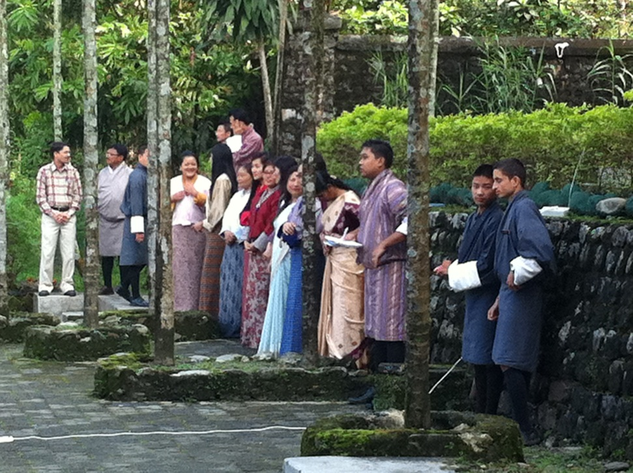
The traditional cognitive discourse as the dominant discourse
Lessons are ‘spoon fed’ and teacher-directed
The teacher is responsible for learning to take place
Learning is acquisition of theoretical and abstract knowledge (curriculum)
Knowledge is considered as the truth
Learning is tested by ability to reproduce presented material
Feedback is given as right-or-wrong-answers
The student learn by taking knowledge in, absorbing it, digesting it and storing it for later use.

Slide 3
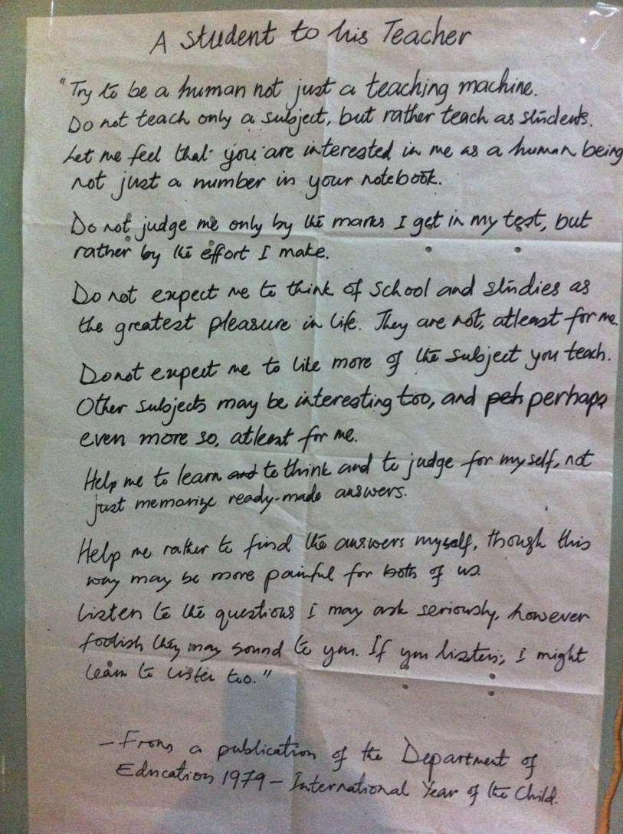
The experiential discourse as an alternative discourse
‘When students are actively involved in the learning process we call it Student Centered learning. Effective learning of facts, knowledge, skills and values takes place when students become active learners.’ (Teacher, history, Samtse).
Mostly used to enhance the learning of theoretical and abstract syllabus through exercise
Can also be teachers using their own experiences, connecting syllabus to problems in reality, excursions etc.
Students calls for examples, dialog, illustrative problem solving and other interactive activities
A limited way of building on experiential learning theory pointing to this discourse as underdeveloped

Slide 4
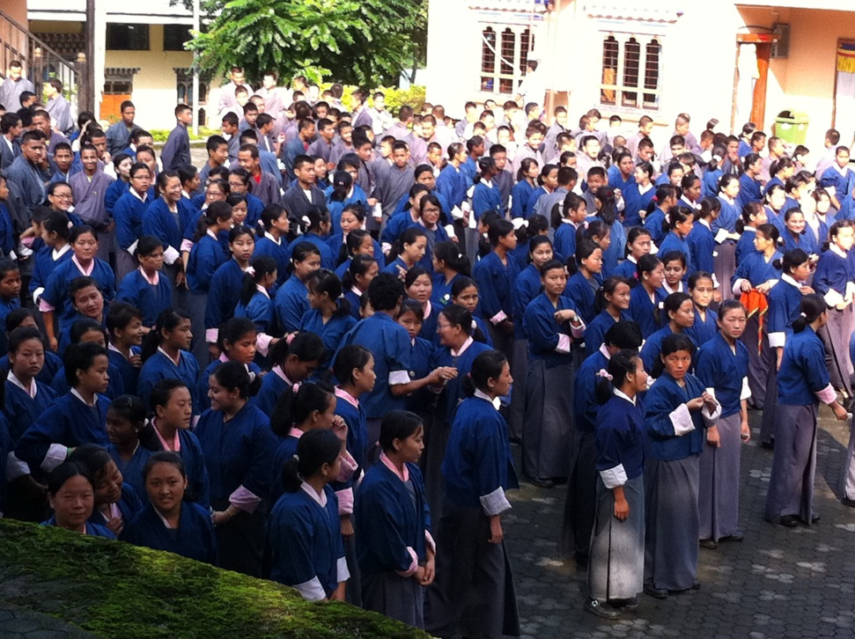
The socio-cultural discourse as a maginalised discourse
Teachers: Acknowledge that the students get some help from friends. Let good students help weak students
Students: Learn from their friends: ‘With friends, we can argue our points. We are at the same level and we tend to find their mistakes. But if it’s a teacher, even if we have some doubts in our mind, we hesitate to say those things. But with friends we can clear out any doubts and argue with them.’ (Student, Gedu).
Parents: Are often not able to help. Perceive their children's (lack of) benefits from school as the fate? Support the idea of their children attending school

Slide 5
Sum up
The traditional cognitive discourse as the dominant:
  Knowledge is considered objective, learning is a cognitive process in which the students form an inner mental understanding of external objects. The process is primarily facilitated by the teachers teaching. The aim is to reproduce curriculum knowledge
The experiential discourse as a limited but recognized discourse
  The student centered activities are primarily done to activate students and get them to participate as a way to learn textbook material more effectively. Secondary the experience based approach is displayed in the teachers' involvement of experience and practical issues in the lessons, which requires that they go beyond the scheduled substance. To a large extent this excess of textbook material is what makes the syllabus more meaningful, puts it in relation to specific problems and reveal teachers' commitment, all elements that the students perceive of as parts of good teaching.
The socio-cultural as a marginalized discourse
  Teachers know that students make use of the knowledge of their friends, but they often experience a negative side of this, since they experience that some students copy work from friends. From the students' point of view, the social transmission of knowledge is much more prominent. They use friends to get answers to questions, increase understanding and discuss the substance

Slide 6
Discussion
What are the consequences of this picture?
  Too passive students?
  Too much mechanical learning: the student can reproduce the content, but understanding and usability is missing?
Is the system effective in terms of learning?
  Or of differentiating the high achievers from low achievers?
How can learning be enhanced?

