Slide 1
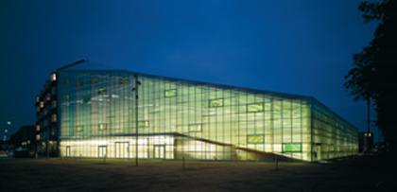
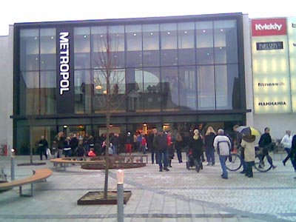
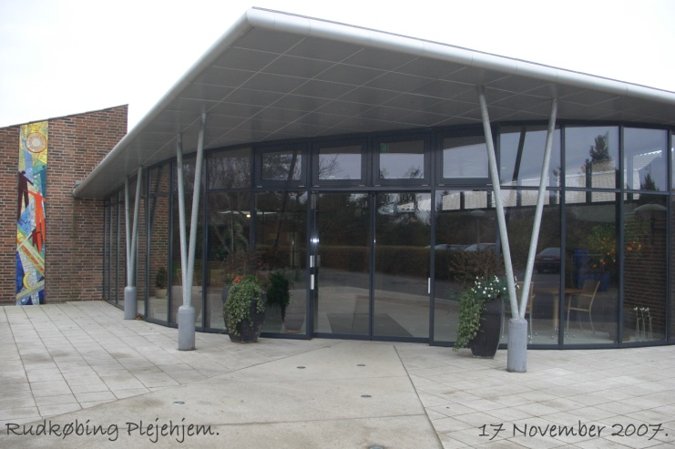
TRACKING AND REGISTRATION OF MOVEMENT PATTERNS IN PUBLIC SPACES
Assisted living
Sports facilities
Libraries
Henrik Harder, Mary-Ann Knudstrup, Valinka Suenson
Aalborg University

Slide 2
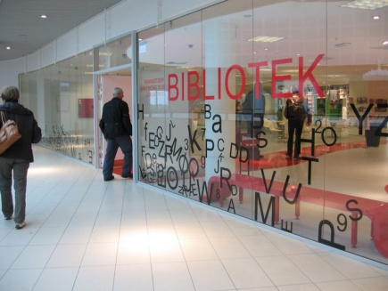
A case study
Hjørring Main Library
METROPOL
Total area: 5,090 m2
- For the audience incl. café: 3,580m2
- The ”Hall” : 360 m2
- For the employees + store room setting: 1,250 m2
Total costs for establishment: 13 mio. kr.
- Library equipment: 3.5 mill. DKK
- Special equipment: 2 mill. DKK
- The Red Ribbon: 2 mill. DKK
- Consultant fee: 1.5 mill. DKK
- IT: 2 mill. DKK
Various: 1.5 mill DKK
Visitors in total in 2008: 330.000
Notes:
They

Slide 3
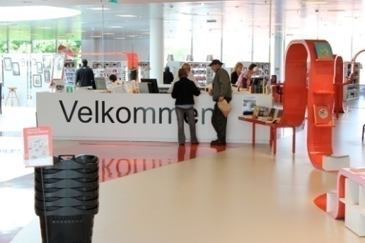
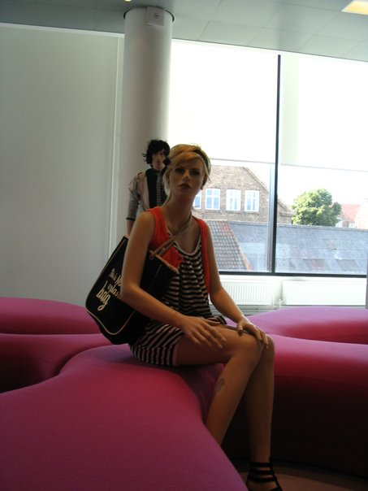
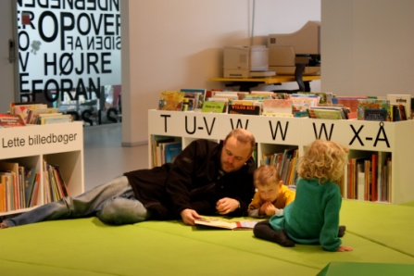
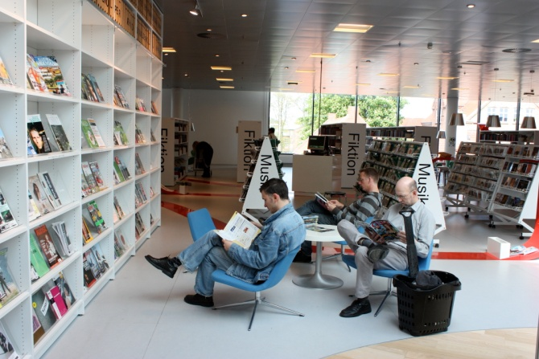
The aim of the research
An insight in the daily life of the Library in Hjørring and an understanding of how the library is used
The objective of the study is to examine how users of the library act in the building - and the patterns of employees etc. are therefore not examined

Slide 4
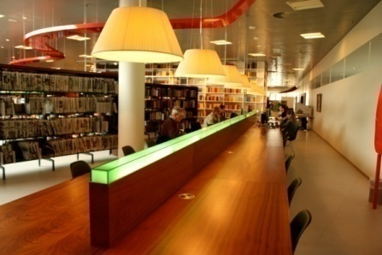
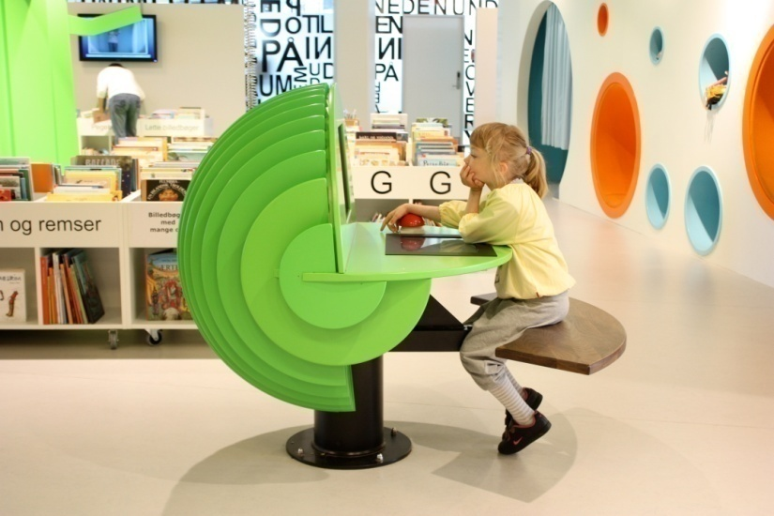
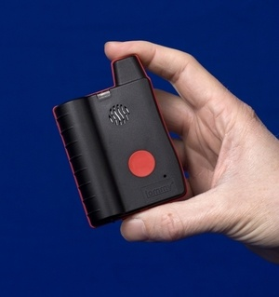
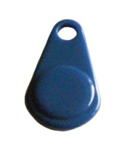
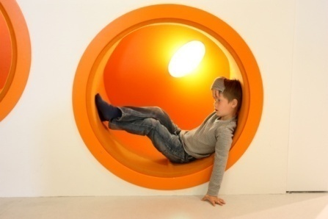
The technical setup when tracking indoor behaviour
:: Using Radio Frequency Identification (RFID) registrations instead of GPS registrations
:: Hardware solution from our supplier:
www.care4all.com
RFID Tags
RFID Scanners
Notes:
input til simpel forklaring, se container centralens side om det: http://www.cc-rfid.com/rfid-what-when-and-why/what-is-rfid.aspx
RFID registrations is a tool for mapping structures for social interaction

Slide 5
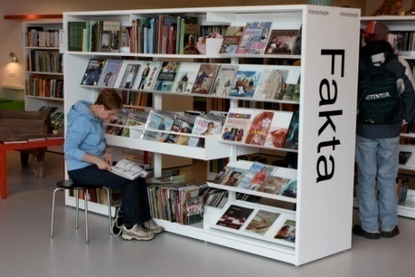
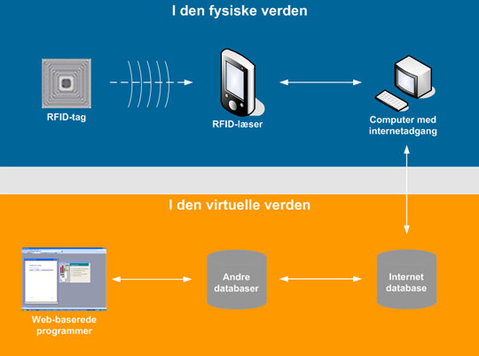
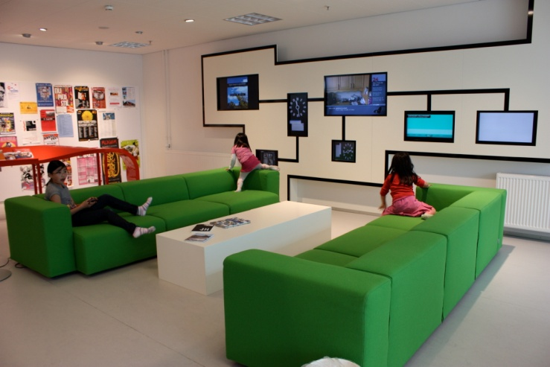
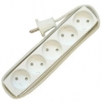
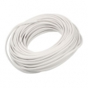
Backstage
Notes:
Preparation: positioning of the scanners, regular or irregular grid, systematisation of scanners

Slide 6
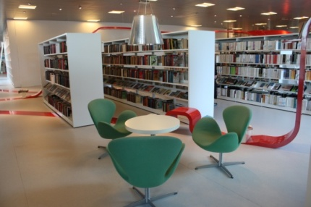
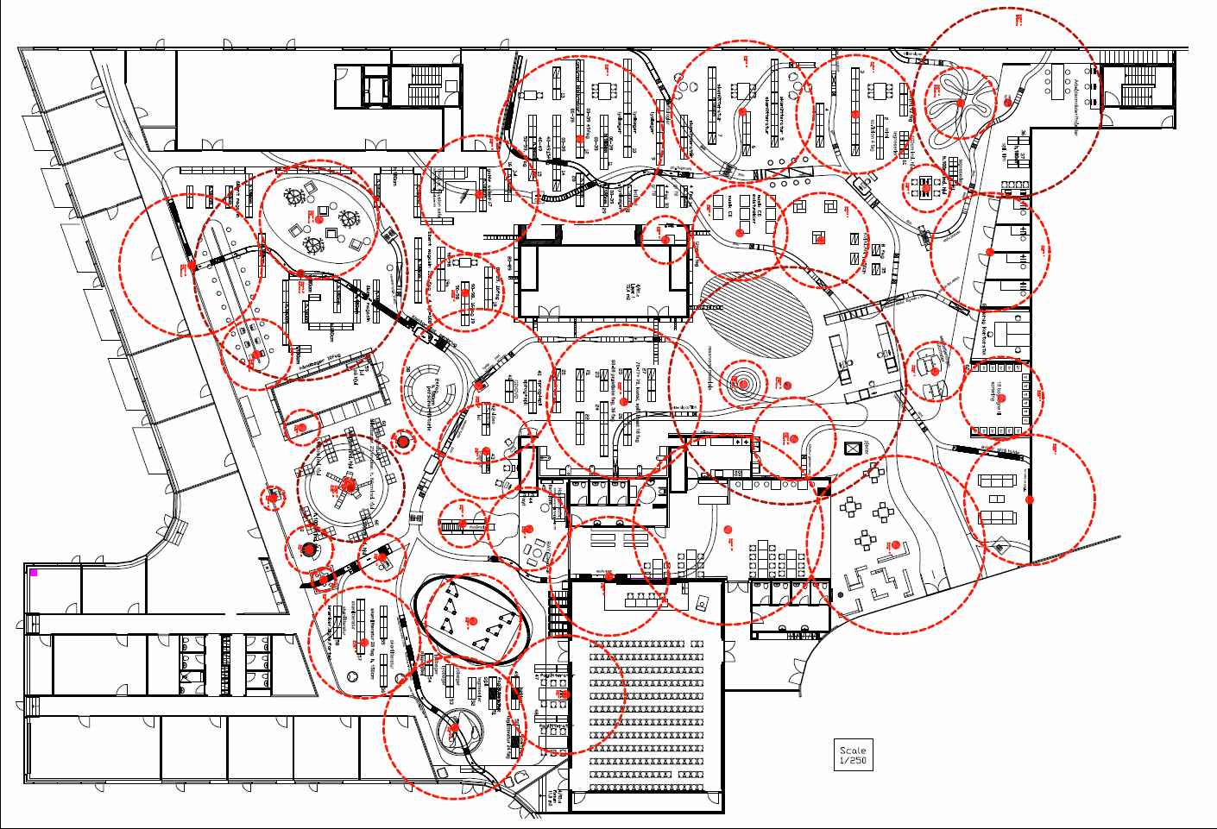
:: RFID scanners will be placed in the Library in Hjørring to register where each RFID tag is moving
:: RFID scanners has an registration radius from 2 meters and up to 50 meters
The Library floor plan with scanners

Slide 7
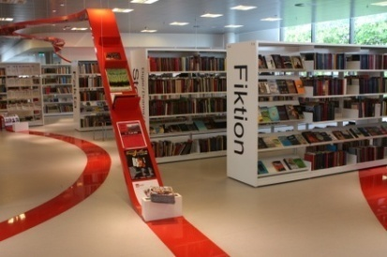
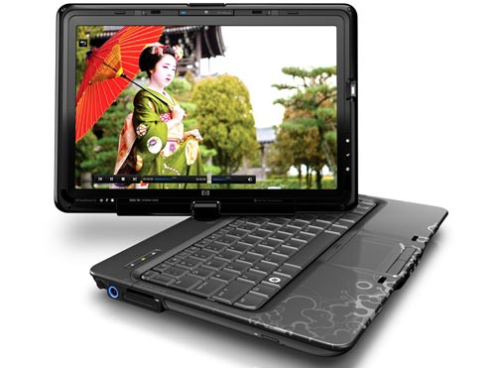
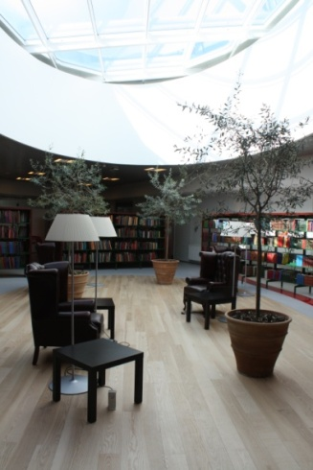
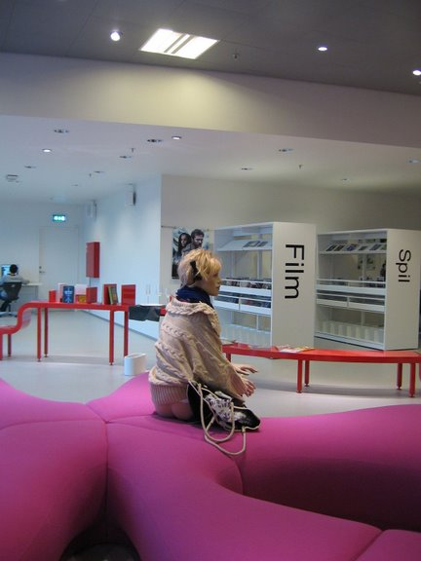
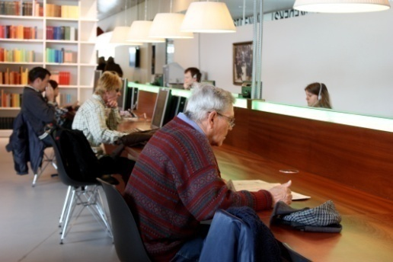
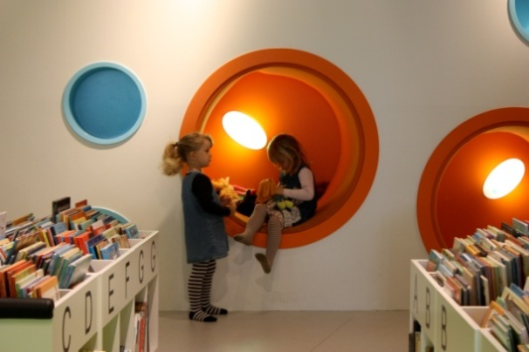
Front stage
:: Selection of representative users
:: Filling in of questionnaires
:: Release of RFID tags
:: RFID tags will be handed in on the way out, to register time of departure
:: Incentives for participating
Touch screen web survey
Notes:
Registration of the users: time of arrival, age, gender, etc.
Purpose of their stay and an appointment of places they will be in during the stay

Slide 8
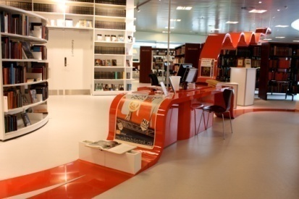
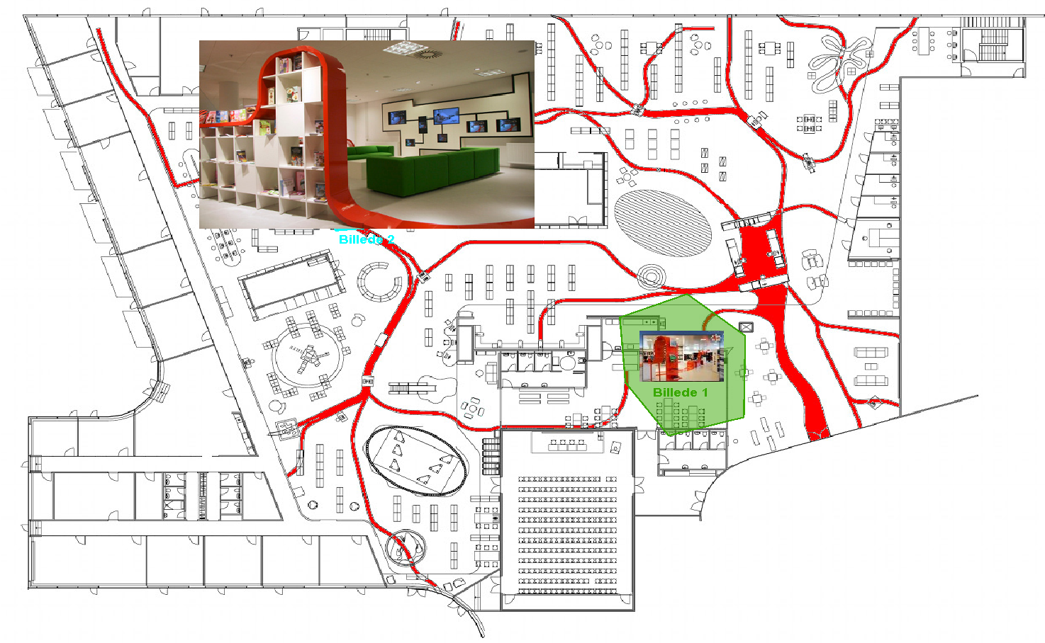
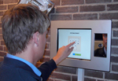
Notes:
Places they like to stay in, and places they don’t like to stay in at the Library in general
It’s easer with a visualization of places in the Library in stead of naming the places with words. For us (backstage) it minimizes the information in the database. For the users the pictures give them a change to recognize the places

Slide 9
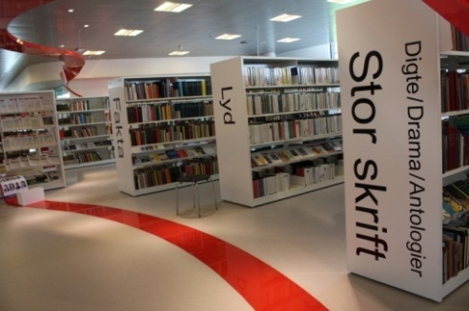
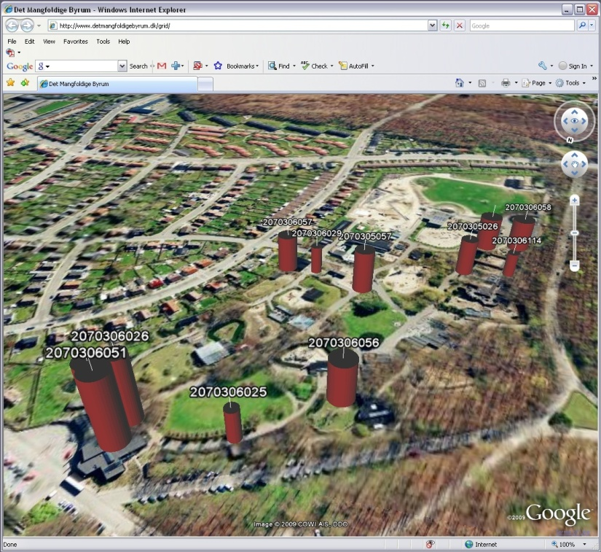
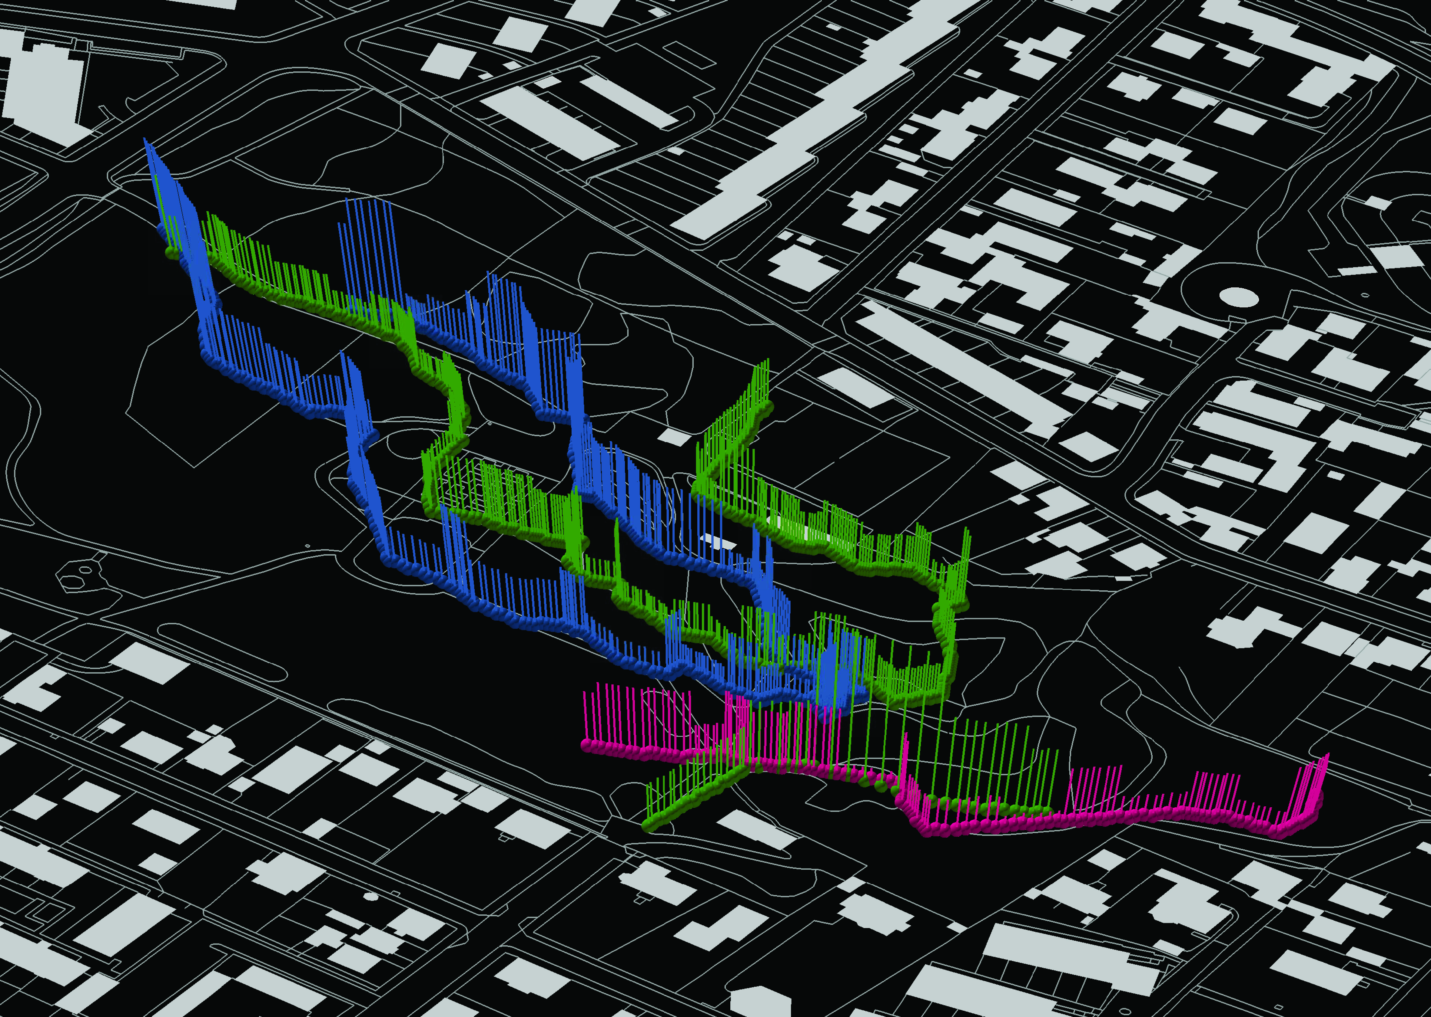
Two kinds of maps
:: An online and real time
mapping of movement patterns in the Library
:: An online and real time mapping of places where the users stay the longest, regarding to gender, age, time of the day etc.
Notes:
These are examples from previous surveys – but they can give you an idea of what kind of information we end up with. We get an online and real time registration of the movement patterns. And it shows if there is a distinction between where they say they are staying, and where they actually are staying. So an idea is that it will show us the non-places as well, the places that are not present in the mind of the users neither the employees. The relation between the rational and the intuitive behaviour. The architecture and the physical surroundings in the Library incites for both ways of behaviour. (whether it is one kind of behaviour or the other also depends on the amount of time the users have during their visit and who they are together with).
The second map is an example of the movement pattern that illustrates each single route of the users. Again this is an example form a survey with GPS registrations, but same type of map will be possible to operate with on the basis of the RFID informations

Slide 10
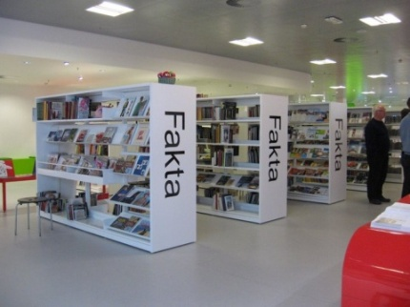
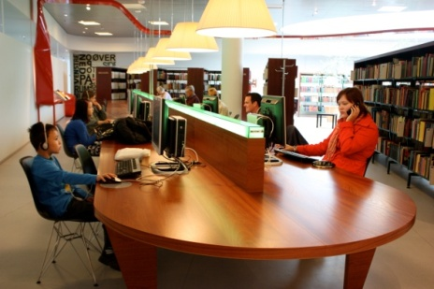
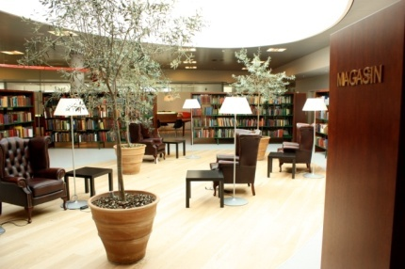
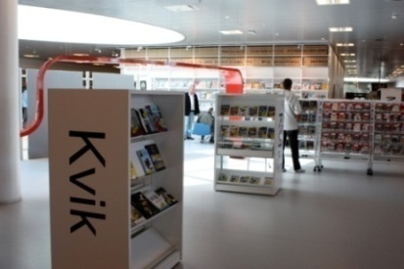
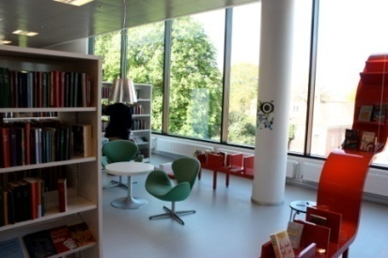
With RFID tracking four questions can be examined
:: How are the public spaces being used differently by different user groups?
:: Who uses which areas in the library?
:: When are these being used?
:: For how long does the different user groups stay in the different areas?
How can the library benefit from the achieved knowledge?
-> get a better understanding of the affordances in the Library
:: Intended and perceived
:: Unintended but perceived
:: Intended but not perceived
Notes:
The Library is a place full of potentials.
In this case the answers to these question will be used to get a better understanding of which affordances (brugspotentialer/ handlemuligheder) there are in the Library, regarding lending out materials and create a social space where people hang out and socialize. A “third place”. Are all these potentials being utilized? Are there any perceived affordances?
Structure (physics surroundings) creates affordances creates behaviour

Slide 11
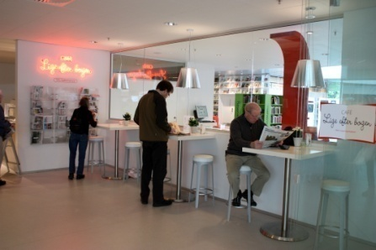
:: Millonig, Alexandra; Gartner, Georg: Shadowing – Tracking – Interviewing. How to Explore Human Spatio-Temporal Behaviour Patterns, 2008, Vienna University, Department of Geoinformation and Cartograghy
:: O’Neil, Michael: Evaluation of a conceptual model of architectural legibility, 1991, Wisconsin University
:: Björneborn, Lennart/ Serendipitetsfaktorer og brugeradfærd på det fysiske bibliotek, 2008, Dansk Biblioteksforskning
:: Edling, Christofer/ A note on social networks and physical space, 2009, Jacobs University, Bremen
:: Glud, Louise Nørgaard ; Harder, Henrik ; Horst, Nicolas Rendtlew ; Simonsen, Anders Kvist ; Tradisauskas, Nerius ; Skov, Henrik ; Lyseen, Anders Knørr ; Bro, Peter ; Henriksen, Susanne ; Poulsen, Jette Sommer. / GPS baseret kortlægning af zoo gæsters brug af Aalborg Zoologiske Have, 2008, Aalborg University, Department of Architecture and Design
:: Harder, Henrik ; Nielsen, Thomas Alexander Sick ; Bro, Peter ; Tradisauskas, Nerius. / Experiences from GPS tracking of visitors in Public Parks in Denmark based on GPS technologies. I: Urbanism on Track : Application of Tracking Technologies in Urbanism. / red. J. van Schaick ; S.C. van der Spek. Amsterdam, 2008
Notes:
Another example of a tracking survey from a park and urban space, made in collaboration with Aalborg city council

