Slide 1
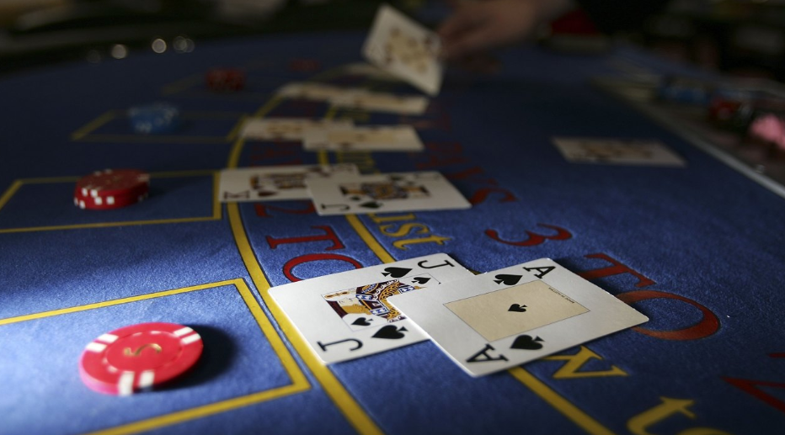


Simulated gambling among young Danes: Findings from a national study
Søren Kristiansen, PhD
Aalborg University
Research Assistant: Majbritt C. Severin
Funding: Spar Nord Foundation

Slide 2
Simulated gambling
…”is a digitally simulated interactive gambling activity that does not directly involve monetary gain but is structurally identical to the standard format of a gambling activity due its wagering features and chance-determined outcomes of play (King et al., 2014:305)
…is a rapidly growing gaming sector that is available through multiple platforms and is proving popular to a wide range of people” (Dickins & Thomas, 2016:19).

Slide 3
Observations and current knowledge
Many simulated gambling games are marketed as youth friendly forms of entertainment causing concerns of early age gambling involvement (Armstrong et al., 2019).
Evidence of video gaming (with gambling themes) as a risk factor for gambling problems later in life (Molde et al., 2019)
Past involvement in simulated digital gambling is associated with higher risk of pathological gambling (King et al., 2014).
Limited amount of research examining possible subtypes of simulated gamblers

Slide 4
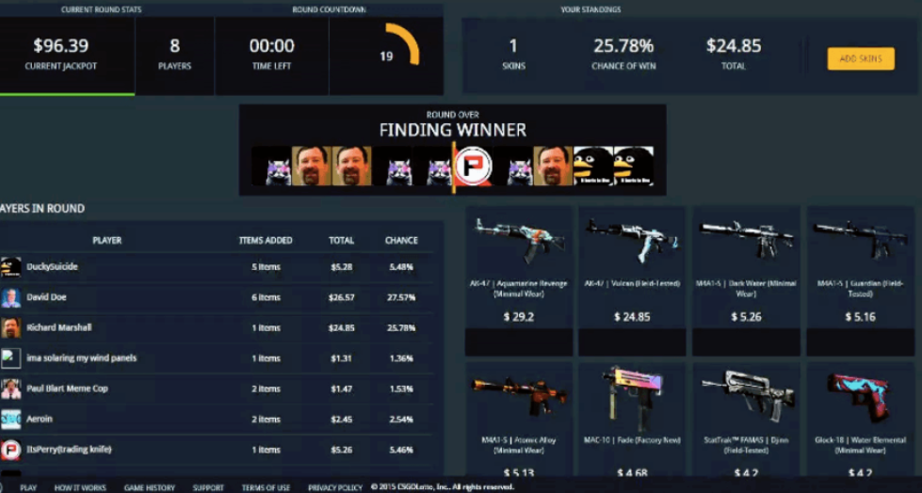
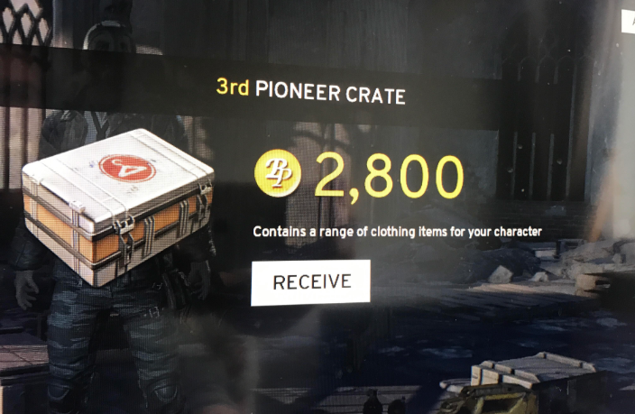
Other dimensions of the ”grey area”
Skin betting: (1) trading skins for money through deposit methods (2) deposit skins on internet sites to gamble with them and withdraw to Steam account
Loot boxes: in‐game reward system that can be purchased repeatedly with real money to obtain a random selection of virtual items (King & Delfabbro 2018).

Slide 5
Study objectives
To explore:
Simulated gambling behavior among young people (12-17) in Denmark
Relations between simulated gambling and monetary gambling
Skin betting and loot box experiences and behavior
Simulated gamblers: Homogeneous group or several types?

Slide 6
Study characteristics
Survey conducted fall 2018. Sample frame (5.000) drawn randomly from the Danish Civil Registration System. Participants 1.137 (RR: 23)
Sample: Mean age: 13,86 (general population: 13,99), female: 50,5%, male: 49,5%
Qualitative interviews March-April 2019

Slide 7
Measures and variables
Demographics
Simulated gambling and monetary gambling behavior
Skin betting and loot boxes
SOGS-RA
Problematic Social Casino Game Use Screen (PSCGS)

Slide 8
Results: Simulated gambling frequency
Daily basis: 23%
Once a week: 17%
Once a month: 13
Once a year: 18%
Never: 29%

Slide 9
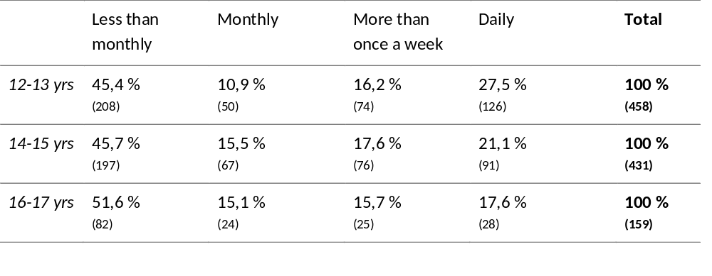
Simulated gambling frequency by age

Slide 10
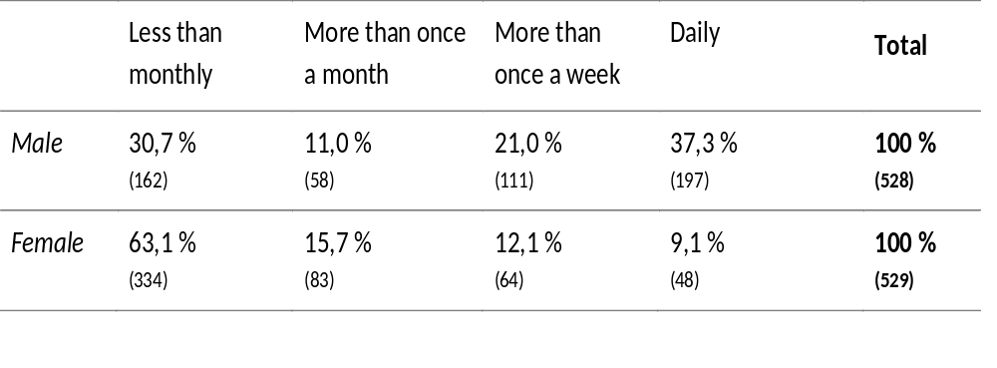
Simulated gambling frequency by gender

Slide 11
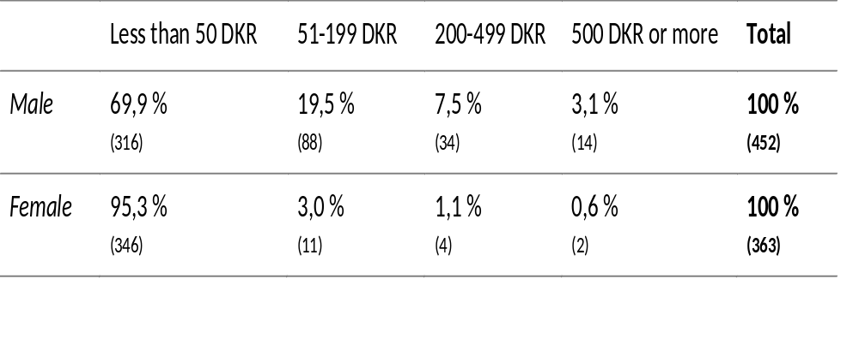
Money spent on simulated gambling/in-game purchases/microtransactions (month)

Slide 12
SOGS-RA score and simulated gambling (M,S.D.)
Non-simulated gamblers | Simulated gamblers | Test for Diff.
0,392 (1,14) | 0,386 (1,07) | p = 0,964

Slide 13
Skin betting and loot box experience

Slide 14
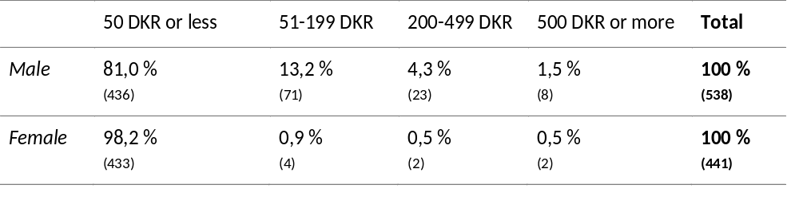
Money spend on loot box and skin betting by gender

Slide 15
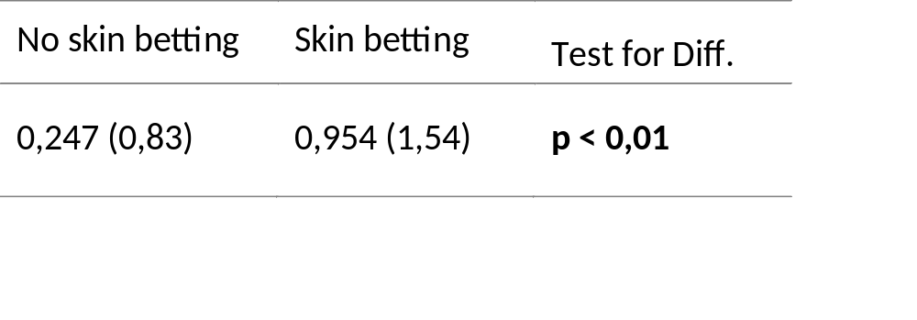
SOGS-RA score and skin betting (M,S.D.)

Slide 16
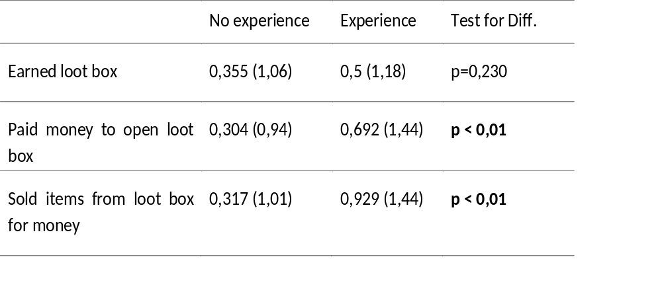
SOGS-RA score and loot box (M,S.D.)

Slide 17
Preliminary and general findings
Close to a quarter of participants engage in simulated gambling on a daily basis
Boys spend more time and money than girls, younger age groups tend to engage more frequently
Relativ low mean level of problematic game use, minority with several indications of problematic use
Next step: Cluster analysis

Slide 18
Cluster analysis
Aim: Identification of groups of youth simulated gamblers who are similar across a variety of variables.
Hierarchical cluster analysis, Squared Euclidian Distance as distance measure
Ward’s method as merging criterion

Slide 19
Variables
Variables for cluster identification (simulated gambling behavior variables)
  Game frequency
  Money spent on games
  Level of social casino gambling problems (PSCGS)
  Number of games tried
Variables to further profiling of clusters
  Indication of monetary gambling problems (SOGS-RA)
  Age
  Gender
  Loot box experience
  Skin betting experience

Slide 20
Cluster differences by simulated gambling behavior. Mean, standard deviation, and 95 % CI.
 | Involved sim gamblers (n=116) |  | Occasional sim gamblers (n=500) |  | Addicted sim gamblers (n=123) |  | Total (n=793)
 | M (S.D.) | CI | M (S.D.) | CI | M (S.D.) | CI
Frequency of plays | 6.6 (2.4) | ±0.44 | 4.6 (2.5) | ±0.21 | 8.0 (1.9) | ±0.43 | 5.5 (2.7)
Use of money | 4.3 (2.0) | ±0.24 | 0.1 (0.5) | ±0.12 | 2.4 (2.4) | ±0.23 | 1.2 (2.1)
Sim gamb problems (PSCGS) | 0.9 (1.2) | ±0.23 | 0.5 (1.0) | ±0.11 | 5.5 (1.8) | ±0.22 | 1.4 (2.2)
Types of games played | 3.6 (1.3) | ±0.26 | 2.6 (1.5) | ±0.12 | 3.5 (1.3) | ±0.25 | 2.9 (1.5)
Note: Items rescaled to 0-10 to ensure comparability across items.

Slide 21
Demographic profile of clusters. Column percentages and χ².
 | Involved sim gamblers (n=116) | Occasional sim gamblers (n=500) | Addicted sim gamblers (n=123) | χ²
Gender Male Female | 90.5 % 9.5 % | 42.2 % 57.8 % | 82.1 % 17.9 % | χ²=129,000, df=2, p<0.001
Age 12-13 14-15 16-17 | 45.7 % 35.3 % 19.0 % | 42.9 % 42.7 % 14.5 % | 53.7 % 34.1 % 12.2 % | χ²=7,068, df=4, p=0.132

Slide 22
Cluster differences by gambling problems and involvement in skin betting, and loot boxing. Column percentages and χ².
 | Involved sim gamblers | Occasional sim gamblers | Addicted sim gamblers | χ²
Gambling problems (SOGS-RA) Non-problem gamblers At-risk gamblers Problem gamblers | 87.7 % 7.0 % 5.3 % | 95.9 % 4.1 % 0.0 % | 80.0 % 10.0 % 10.0 % | χ²=20,877, df=4, p<0.001
Participated in skin betting Yes No | 25.0 % 75.0 % | 8.3 % 91.7 % | 28.0 % 72.0 % | χ²=40,774, df=2, p<0.001
Earned loot box Yes No | 69.1 % 30.9 % | 39.9 % 60.1 % | 73.5 % 26.5 % | χ²=59,396, df=2, p<0.001
Bought loot box Yes No | 43.4 % 56.6 % | 12.3 % 87.7 % | 43.3 % 56.7 % | χ²=82,380, df=2, p<0.001
Sold items from loot box Yes No | 23.0 % 77.0 % | 6.6 % 93.4 % | 19.3 % 80.7 % | χ²=32,283, df=2, p<0.001

Slide 23
Key points and next steps
Simulated gambling games are played by a substantial portion of young Danish people
Gendered phenomenon: Femlas are less involved, experience fewer problems than males
Three distinct types of simulated gamblers
Further profiling of types by qualitative data
Examining links between simulated gambling and monetary gambling by qualitative data.

Slide 24
Thank you!

