Slide 1
Body surface mapping of
the cardiac activity
Kim Munck, Bolette Dybkjær Hansen, Nina Jacobsen, Louise Pedersen Pilgaard, Samuel Schmidt, Kasper Sørensen, Johannes jan struijk

Slide 2
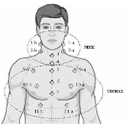
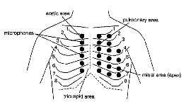
Background
Chest surface Measurement shows potentials in diagnosing heart failure [1]
  Heart valve sounds
  Murmurs
  SeismoCardioGraphy (SCG)
Body Surface Mapping (BSM) of heart sound
  Indicator for diagnosis of sleep aphnoea [2]
  Origin of heart sounds and murmurs [3]
[2]
Hu Y, Kim EG, Cao G, Liu S, Wu Y. "Physiological acoustic sensing based on accelerometers: A survey for mobile healthcare", Annals of Biomedical Engineering 2014
Rendón DB, Ojeda JLR, Foix LFC, Morillo DS, Fernández MA. "Mapping the human body for vibration using an accelerometer", IEEE EMBS 2007;23–26
Durand MCLG, Guardo R. "Development of a cardiac acoustic mapping system", Med Biol Eng Comput 1998
[3]

Slide 3
Aim
BSM of the mechanical cardiac activity
  Low frequency (<0.25 Hz)
  Mapping the displacement of the chest area
  Finding identifiers between the cardiac events and the map
Aim:
  Evaluate BSM for exploration of the mechanical cardiac activities

Slide 4
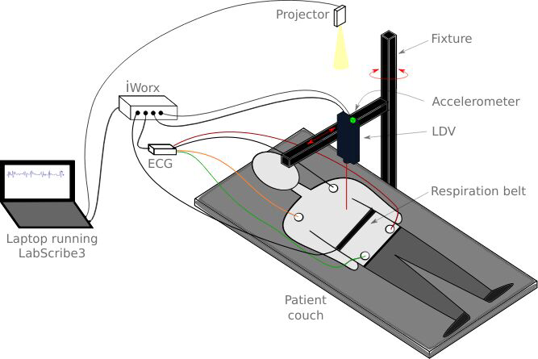
Method – Experimental setup
Laser Doppler Vibrometer (LDV)
ElectroCardioGraphy (ECG)
Respiration belt
Accelerometer (Fixture noise)
Projected grid (Considency)

Slide 5
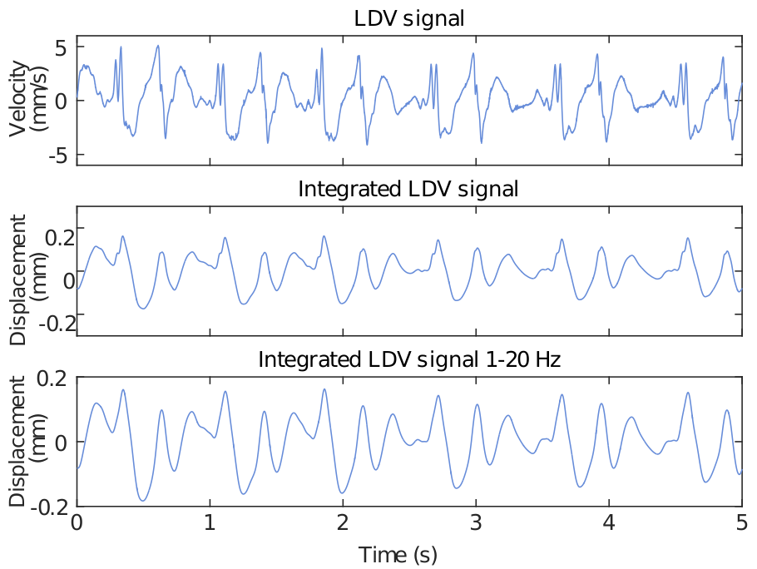
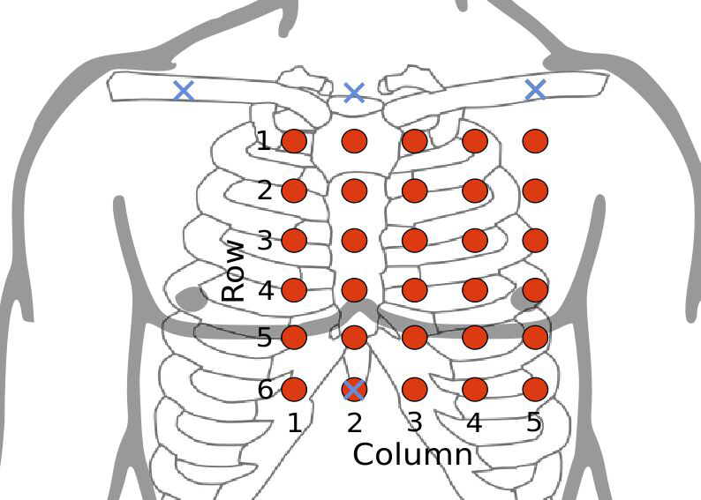
Signal sampling, filtering and transformation
5x6 spatial resolution
1-20 Hz filtering (low frequency)
Velocity to displacement

Slide 6
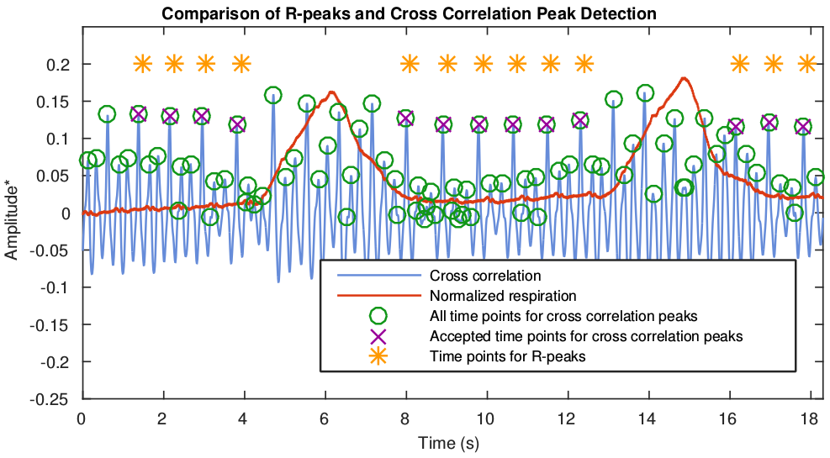
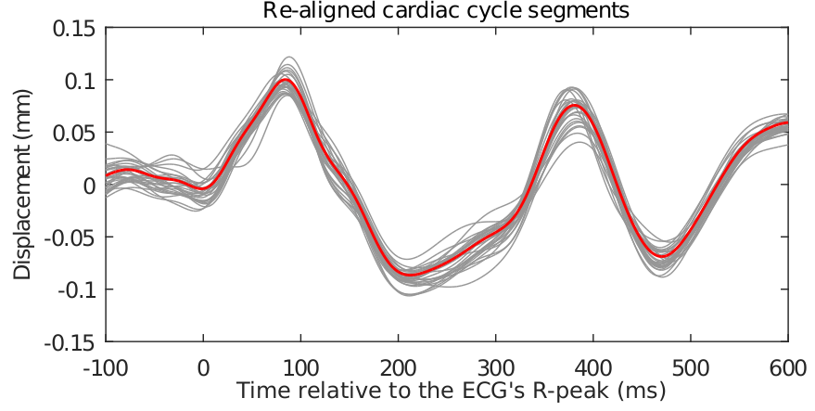
Segmentation and re-alignment by cross-correlation
R-peak detection
Exclude respiration periods
Mean segment
Cross-correlation correction
Re-aligned mean segment

Slide 7
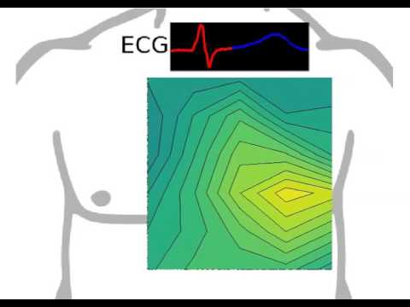
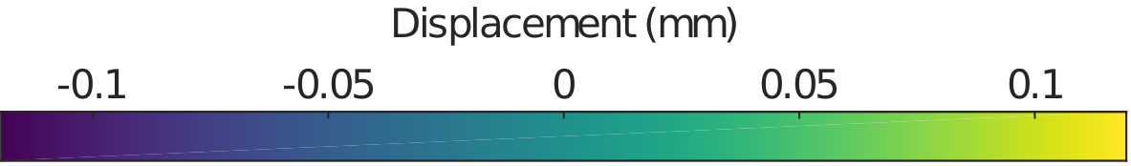
Results
https://www.youtube.com/watch?v=QAzsT6JHY9M

Slide 8
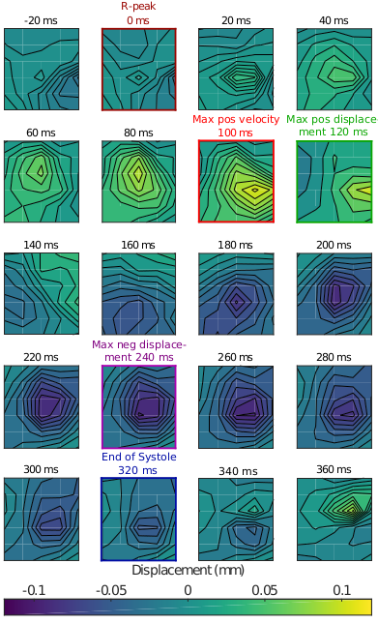
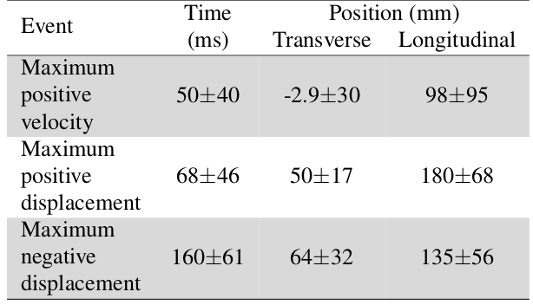
Results - quantifiable
Identifiers across subjects
Identifiers features
  Latency (S1 heart sound)
  Spatial position (X,Y)
  Amplitude (Z)
Table 1: Feature values of identifiers as mean±std, where time is relative to the S1 heart sound and position is relative to the sternum and the lowest point of the grid.

Slide 9
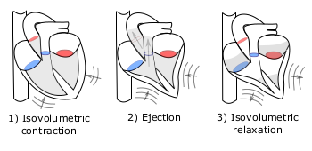
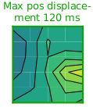
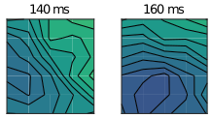
Discussion
Relate identifiers to cardiac events
  Maximum Positive Velocity
    End of isovolumetric contraction [4]
    Agrees with O'Rourke et al. [5]
  Maximum Positive Displacement
    End of rapid ejection [5]
  Maximum Negative Displacement
    Left ventricular retraction [5]
      Well before S2 heart sound
  Opposite displacements
    Rotation [4,5]

Slide 10
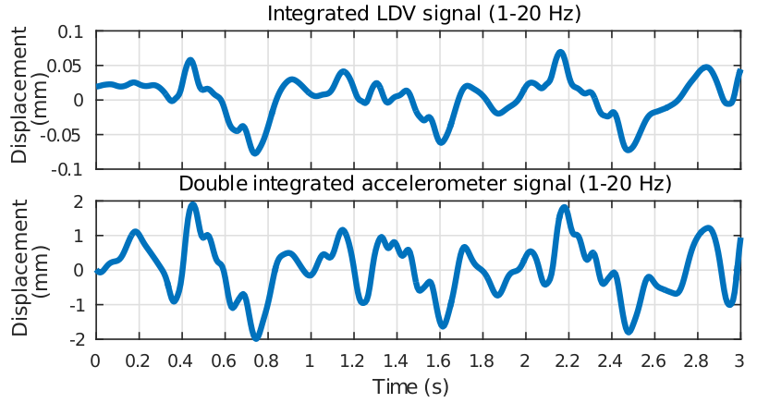
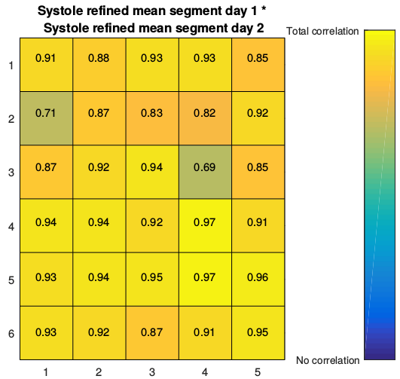
Further studies and conclusion
Further studies
  Better understanding of the
  LDV vs Accelerometer
    Doppler Monte Carlo Model
  Measuring grid points simultaneous
  Substituting the LDV
  Larger population
    Diagnosed subjects
  Cardiac event reference (ECHO, arterial pressure)
Conclusion
  Results was reproducible
  Concordance with existing evidence
  Further studies are needed

Slide 11
References
Hu Y, Kim EG, Cao G, Liu S, Wu Y. "Physiological acoustic sensing based on accelerometers: A survey for mobile healthcare", Annals of Biomedical Engineering 2014
Rendón DB, Ojeda JLR, Foix LFC, Morillo DS, Fernández MA. "Mapping the human body for vibration using an accelerometer", IEEE EMBS 2007;23–26
Durand MCLG, Guardo R. "Development of a cardiac acoustic mapping system", Med Biol Eng Comput 1998
Luo X, Cao T, Li Z, Duan YA "Preliminary study on the evaluation of relationship between left ventricular torsion and cardiac cycle phase by two-dimentional ultrasound speckle tracking imaging" Int J Cadiovase Imaging, May 2009, 25(6): 559-568
O'Rourke R A, Shaver J A , Silverman M. E, "Hurst's The Heart", The McGraw-Hill Companies, 2008: 215-293

